Slide 1
WELCOME

Slide 2

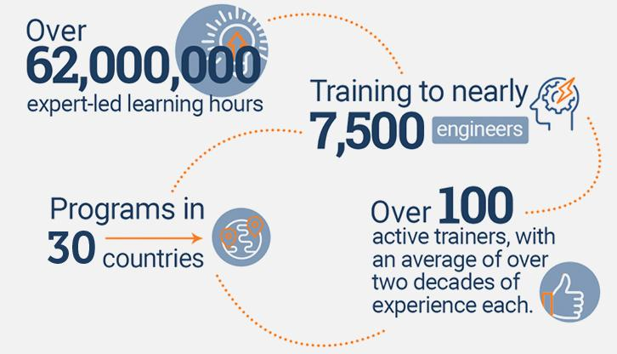
An Overview
Our purpose…
We help organizations learn and adopt new technologies.
In 2018 alone...
…Impacts you daily.
When you talk on the phone, watch a movie, connect with friends on social media, drive a car, fly on a plane, pay with a credit card, shop online, and order a latte with your mobile app, you are interacting with technology developed by one of our customers.
Notes:
Share a bit about DevelopIntelligence
- As developers you want to learn!
- As a corporation you want your developers to align their learning with your business goals.
- That’s where we come in… Keeping developers current, bringing others up-to-speed … all aimed at moving your business forward!
- We started in 2003 by a Sun Microsystems developer that wanted to help developers level-up and see business better leverage IT

Slide 3
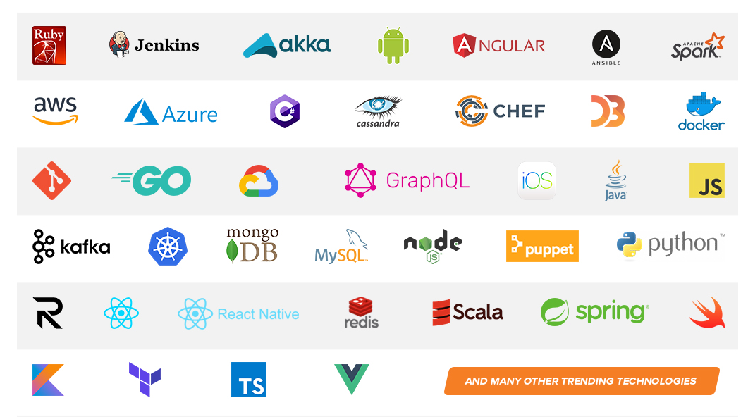
Technologies we cover
Notes:
Areas of DevelopIntelligence expertise
DevOps: Ansible / Jenkins
BigData: Hadoop / Cassandra / Spark
Machine Learning
Front-end: React / Angular
Cloud: AWS / Azure / Google Cloud
- Started as a Java shop -> keep growing -> haven’t looked back
- Our specialty is hiring expert practitioners that can come alongside teams and teach them how to move forward

Slide 4
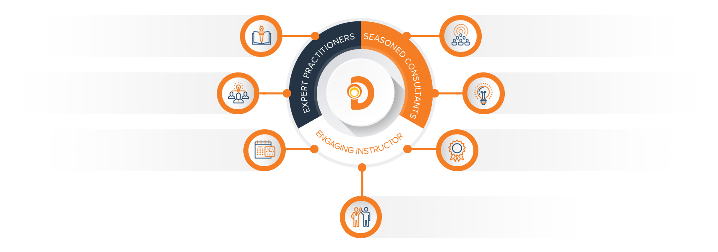
Our Practitioners
250 best selling
books authored
150 engagements speaking
at industry conferences
9+ years of training
experience
Over 17 years of industry
experience per instructor
750,000 practitioner led
training hours
125 certifications in leading
technologies
95% instructor satisfaction

Slide 5
Data Architecture Fundamentals
Instructor Name
Credentials

Slide 6
Data Architecture Objectives
The objectives of this course are as follows:
Help students get a better understanding of fundamental tools for extraction, transformation and loading in a data engineering pipeline
Give students the ability to design a data engineering pipeline using commonly used AWS tools
Students will gain an understanding of commonly used data structures for data in transit.

Slide 7
Agenda
Our day
Data Architecture Fundamentals (1.5 hours) (0700-0830)
Three Pillars of effective data architecture
Systems of Data Architecture
30 minute break (0830-0900)
Lab One: Intro to diagrams.net tool (1 hour) (0900-1000)
The ETL Process (1.5 hours) (1000-1130)
Data Sources (basic)
Transformation Tools (basic)
Storage Tools (basic)
Lunch (1 hour) (1130-1230)

Slide 8
Agenda
Our Day (continued)
Lab Two: First scenario: Basic SFTP (1 hour) (1230-1330)
Deeper Dive into ETL Tools (1 hour) (1330-1430)
Lab Three: Scenario TWO and THREE (1.5 hours) (1430-1600)
Extra: Scenario FOUR if we have time

Slide 9
Architecture
Data engineering is the aspect of data science that focuses on practical applications of data collection and analysis.
Essentially, as Data engineers, one of our primary jobs is to ensure that data makes it from the source of the data to the target of the data (usually a database, RDBMS or visualization system)
So let’s break this down…

Slide 10
Architecture
So when we conceive of data flowing through a system have to consider the same questions we would have when designing a plumbing system to move water
Stick with this metaphor as we design our system!

Slide 11
Three Pillars of Good data Architecture

Slide 12
Architecture
What are some considerations when you are designing a plumbing system?
Speed of water through the system
How are you going to “cleanse” the system/data?
How do you deal with blockages?
What if the system gets backed up?
How do we access data in each step?
In other words how do we stop the flow to make sure things are moving?
Should the flow stop at certain points?
How do we make sure we don’t “lose” water

Slide 13
Architecture
Considering all of this we need to think about each step of our system. By now we are familiar with the three things that need to happen in a data engineering system- the
Extraction of data (the source of the water flow through our pipes)
Transformation of data (how do we cleanse it before it reaches where it needs to go)
Loading of data (where it’s all going)
BUT…when we’re talking about architecture we need to consider other factors like:
VELOCITY of data (how fast is it moving?)
RESILIENCE of data (how do we NOT LOSE it?)
REPLAYABILITY of data (how do we replay it if our target cannot process it?)

Slide 14
Velocity of data
Some questions around the velocity of data
Does the end consumer NEED data in real time/near real time?
Are there any actual, effective, realistic actions that can be taken by the end user based on the data that you’re sending?
Is it possible to accidentally panic everyone based on real time data?
What are some other advantages of high vs low velocity?
Notes:
Have the team take a minute to talk through velocity situations

Slide 15
Resilience
Some questions on resilience:
How will we handle problems with the data?
How will we manage issues where the pipeline gets clogged?
How many retries will we run with the incoming data that we have?
How can we get in and ‘see’ the data?
Notes:
Have the team take a minute to talk through resilience situations

Slide 16
Replayability
Some questions on replayability:
Is “replayability” even a word in the English language?
Okay- maybe not but you totally know what we mean!
In all sincerity…in case of error: how can I replay data that has failed to be inserted into a target database?
Assuming your data pipeline breaks for three days…how can I replay past transactions?
Is the order that data goes into the target a necessary component? Or can we put data in out of order?
Notes:
Have the team take a minute to talk through resilience situations

Slide 17
Bringing everything together
Okay- so with these three aspects in mind (at a very simple and a very high level) we’re going to look at some of the different ways that we design a data architecture in AWS
As we go through the following examples please think about how some of these concepts exist in your current data engineering/data pipeline setups.

Slide 18
Architecture
Now- as with plumbing system- data engineering architecture comes down to understanding systems which we visually represent with architecture diagrams.
These architecture drawings represent different parts of a system. Each part does a small job and we wire these together into a data engineering architecture system.

Slide 19
Architecture

Slide 20
Three systems of proper data architecture

Slide 21
First questions on sources
BATCHES vs STREAMS vs EVENTS
The first thing we need to ask ourselves is “what kind of consumer are we designing?”
Will the consumer:
Run on a TIME schedule? (i.e: Every N hours/minutes/seconds)
This is a BATCH consumption system
The data is built up and built up and built up and then consumed on a schedule
EVENT Driven?
Run based on something happening? (i.e: a file landing on a drive? Some other process ending?)
STREAMING?
Running “constantly”- like a STREAM of data
Notes:
Databases include:
RDBMS
NOSQL- so…these are usually JSON formatted
LOG SYSTEMS:
These are almost always some version of a text file though they end with the extension .log
Typically these are read into memory by a program and transformed in code These are TRANSFORMATION HEAVY
USER GENERATED: Mostly web forms…things like “birth date, address, first/last name”…the type of stuff you put into sites to “create an account”. Usually very little transformation required as the data cleansing is done in the front end.

Slide 22
Batch Processing
Figuring out the CONSUMPTION pattern for these systems is the start.
Historically everyone did batches:
Sometimes it was 5 minutes/3 minutes/etc
VERY resilient- new files can be regenerated as required
Excellent replayability

Slide 23
Event Driven Architecture
NOWADAYS more and more of these pipelines are becoming event driven- i.e: as soon as a new piece of data “arrives” the pipeline is “triggered
Event driven architecture is:
Excellent resiliency
Excellent velocity (very fast, i.e: near real time)
POOR replayability

Slide 24
Streaming data
Some questions around streaming data systems
How can I verify the data consumed from the stream is properly structured?
How can I replay the data coming in from the stream?
Does order matter in the stream data coming in?
How can I ‘look’ at the data in the stream?

Slide 25
Type Summary
Type | Velocity | Resilience | Replayability
Batch Data | Low | High | High
Event Driven Data | High | Medium | Low
Streaming data | Extremely High | Medium | Low

Slide 26
DATA SOURCES

Slide 27
Third questions on sources
Finally we have to figure out how we’re getting the data?
POLLING?
Check for new data every “N” hours/minutes/seconds
STREAMING?
Create a “web socket” connection so that the data flows in to your system constantly
EVENT DRIVEN
Using a watcher on the source that constantly checks for changes in the drive- i.e: a new file being generated or being written to

Slide 28
Various sources
So where do we get data from? Let’s go through some sources…
Caching Systems:
Other Databases
Very little Data cleansing required
Usually batch loaded
Front end caching systems
Usually a JSON store stored on the browser; stuff like DynamoDB
Logs
Web logs
Intense transformation
Involves reading entire files (usually ending with the “.log” extension)
There are options to use third party systems like ELK to parse these
System logs
Less transformation than web logs BUT
Usually needed in Near Real Time
Notes:
Databases include:
RDBMS
NOSQL- so…these are usually JSON formatted
LOG SYSTEMS:
These are almost always some version of a text file though they end with the extension .log
Typically these are read into memory by a program and transformed in code These are TRANSFORMATION HEAVY
USER GENERATED: Mostly web forms…things like “birth date, address, first/last name”…the type of stuff you put into sites to “create an account”. Usually very little transformation required as the data cleansing is done in the front end.

Slide 29
Data Sources (continued)
User generated
Web forms
Very little transformation needed as the front end is usually responsible for cleansing
Drop down menus
Radio buttons
Stored in both memory in the back end AND sent to the database
Uploaded csv/excel files
Intense cleaning and transformation needed
Any User Generated Content needs to be cleansed before being read into memory

Slide 30
Data Sources (continued)
APIs
Web socket connections
Think chat systems like ”Slack” or Facebook messenger
Real time (or near real time) transfer of data- think of it like a phone call
Extremely fast transformation is required for data en route (including cleansing)
Will probably require a queue prior to being put into a database because the data is coming so fast
HTTP connections
Fundamentally “stateless”- one call has no idea what the previous call did
Usually required to update settings in the url
Data comes in BATCHES so you can decide the speed of incoming data to put into database

Slide 31
Data Sources (continued)
SFTP:
File Transfers into Secure File Transfer Protocol
Think of it like a mail box where a third party puts a file
We would use code to read that file into memory and then put it into a database
We can decide the speed of data coming in and batch load it
Queues:
Think of queues as a buffer to manage the speed of incoming data
Queues provide state to incoming data…so data coming in too fast from a previous step can be “remembered” (retained) for a set period until consumed
This allows us to push data “as and when” instead of risking the collapse of the entire system!

Slide 32
Data Sources (continued)
Memcache caches
There are cases when we might want a cache in between the users and the database due to the amount of time it takes to run a sql query
Think video games: we don’t have time to run an entire SQL query every time Mario wants to add a coin to his total, right?
So we need a SUPER FAST method to do this…hence the caching layer
Think REDIS/Memcache
Usually just a basic key/value store
There are times when you will need to pull data from the caching layer into a SQL database

Slide 33
TRANSFORMATION TOOLS

Slide 34
Transformation layer
So we have looked at some various sources of data- let’s look at some of the common tools used to transform data:
SPARK:
Uses RDDs which are defined as a read-only, partitioned collection of records
SPARK uses these and transforms the data either FILTERING, MAPPING, or JOINING different RDDs
The data flowing through is altered
Stream Transformation
For high velocity data flowing through the ”pipe”- makes basic transformations
Can change structure of the data
Actually runs between the PRODUCER of the data and the CONSUMER of the data

Slide 35
Transformation layer
LAMBDA/Google Functions/AZURE
Small, insulated pieces of code that are triggered by data flowing through a pipe
So you have one of these pieces of code “subscribed” to a queue of some sort
Every time a piece of data is added to the queue the code is triggered and runs to make all necessary transformations
There is no server management required as AWS/Google/Azure handles it for you
These act as “consumers” at the other end of the pipeline

Slide 36
Transformation Layer
Python PANDAS
AWESOME tool for quickly transforming data while maintaining basic structures
Chock FULL of awesome machine learning algorithms
Python PANDAS
AWESOME tool for quickly transforming data while maintaining basic structures
Chock FULL of awesome machine learning algorithms

Slide 37
So what does the data look like going through?
So how does the data look as it passes through the stream?
JSON: JavaScript Object Notation

Slide 38
So what does the data look like going through?
AVRO
Developed by the creator of Hadoop
Creates schemas using JSON
Basically it breaks everything down into binary format defined in a SCHEMA. The technical definition is that avro:
Uses JSON for defining data types and protocols, and serializes data in a compact binary format
Consider that JSON is defining the METADATA while the DATA itself is stored in BINARY allowing fast access

Slide 39
Parquet file storage
Parquet
Apache Parquet is designed for efficient as well as performant flat columnar storage format of data compared to row based files like CSV or TSV files
Parquet is optimized to work with complex data in bulk and features different ways for efficient data compression and encoding types.
When querying, columnar storage you can skip over the non-relevant data very quickly. As a result, aggregation queries are less time consuming compared to row-oriented databases (or files like CSV or TSV)
Parquet is built from the ground up. Hence it is able to support advanced nested data structures. The layout of Parquet data files is optimized for queries that process large volumes of data, in the gigabyte range for each individual file.

Slide 40
Parquet file storage
Parquet is built to support flexible compression options and efficient encoding schemes. As the data type for each column is quite similar, the compression of each column is straightforward (which makes queries even faster).
Data can be compressed by using one of the several codecs available; as a result, different data files can be compressed differently.
Basically- Parquet is made to be flexible enough to store various types of data efficiently

Slide 41
Parquet
DataSet | Size on Amazon S3 | Query Run time | Data Scanned | Cost
CSV Files | 1 Terrabyte | 236 seconds | 1.15 TB | $5.75
Parquet Format | 130 GB | 6.78 seconds | 2.51GB | $0.01
Savings | 87% less when using Parquet | 34x faster | 99% less data scanned | 99.7% savings

Slide 42
Storage Tools

Slide 43
Storage
So at this point in our journey we’ve been through GETTING DATA, and TRANSFORMING data.
Our final step here is “STORING DATA”– the final step in the “flow of data” through our system.
We have numerous tools here at our disposal:
S3 Bucket
Mounted System
Relational Database Management System
NOSQL
MongoDB
DynamoDB
Hadoop

Slide 44
Storage
S3 Buckets/Google Storage
Basically these are file directories that exist in the cloud and will store FILES for you
The idea here is that after you receive data you can write that data to a file and store it in a directory.
USUALLY the directory structures here are:
YYYY/MM/DD/HH
You write programs to read from these files and send data through
This is the most resilient type of data storage

Slide 45
Storage
Relational DataBase Management System
MYSQL/Postgresql
INSERT and UPDATE operations
These are reasonably fast but not always fast enough to keep up with super high velocity data
Queries tend to slow down at extremely high data volumes
Usually used for data warehousing
FAIRLY resilient (but not perfect)
NOT super fast

Slide 46
Storage
NOSQL
Avoids the need for transformations
Lightning fast
Easy to replay
Usually a key/value store of some sort
OVERWRITES on the same key
Not usually used for long term data science/evaluation

Slide 47
Storage
Elastic Block Store
Another option for writing files is to write files to a specific directory in a server
That directory can then be ”removed” and “pasted on” to another server even if the rest of the server goes down
This is the “Elastic Block Store”…think of it as a directory “mounted” on a server. EVEN IF the server dies the directory continues to exist and can be mounted onto another server as necessary

Slide 48
Tools Lab
So now we’re going to put this into practice.
In this next section I’m going to give you a challenge based on real life experiences and ask everyone to create a drawing based on the tools that we’ve been over
Before we go into this next section though I want to make sure that everyone has a good summary grasp of all the tools we went over in the previous section…so let’s review each of these one more time.

Slide 49
Putting it all together: SOURCES

Slide 50
SFTP SERVER
Usually an Amazon EC2 instance with (S)FTP ports open
Think of these like a “mailbox”:
Reports are put on a ”DRIVE”, usually in CSV, TSV, XLS, PARQUET, etc format
It is up to YOU to collect these files on a schedule with some coding mechanism
Advantages:
Easy replayability
Easy to see
Simple to use
Disadvantages
Batch Only
No guarantee of “clean” data
Polling necessary

Slide 51
CACHING systems
Frequently used by Front/Back end to “cache” data for recently visited websites or frequent user interest stories
These store data in BINARY format with the main intent behind them being that the data comes back extremely quickly
Advantages:
Data is returned extremely quickly
Easy key retrieval
Organized data
Disadvantages:
Data is in binary format so transformation is almost always required
Difficult to parse/transform in stream

Slide 52
Web or System Logs
Web/System logs created by requests coming into server or various things being done by the server.
Very Common to parse and ingest these
Advantages:
Replayability is awesome
There are always records left behind so small chance of “losing data”
Disadvantages:
Transformation and parsing is frequently difficult and nightmarish
A lot of possible errors to account for

Slide 53
User Generated Content
User generated content consumption is data directly from the user
Usually uploaded in any of a few methods:
Some file (Excel, CSV, etc)
Web Forms (usually parsed to JSON)
Advantages:
The data is definitely correct- no need for verification!
High velocity- usually based on triggers
Disadvantages:
A LOT of cleaning will be necessary (people can’t spell wrods correctly)
Batching is next to impossible

Slide 54
APIs
APIs are probably the most common forms of consumption. Data will come in JSON or XML format (99% of the time)
Advantages:
Easy to query previous data
Data is frequently “batched” with http requests going back and forth
Replayability and velocity are controlled by you
Disadvantages:
Usually authenticating to these APIs is a painful experience
Differing structures of data coming in
Versioning can be painful

Slide 55
Websockets/Streams
Websockets are like APIs but you go beyond “stateless” http
Kinesis are streams that come in constantly with fast data
Advantages:
BLAZING fast incoming data
The only thing slowing consumption is how fast you can code everything out
Can do transformations for you in stream
Will retain data if you can’t keep up
Disadvantages:
Blazing fast data means that replayability is terrible
Not tolerant of downtime on your end

Slide 56
QUEUES
Queuing systems allow you to consume data as it comes in (and can be used as a trigger) whilst retaining that data (sometimes in order!)
Advantages:
Retains data if consumers can’t keep up
Can work as fast as the consumers can
Excellent and safe way to retain data as it moves
Disadvantages:
”Lump in the snake” problem when consumption falls behind
Not always FIFO
Difficult to see data in transit

Slide 57
Putting it all together: TRANSFORMERS

Slide 58
Python PANDAS and R
Pandas and R are data science tools intended to parse data BUT…they can also run calculations on data as they run through your ETL!
Advantages:
Pandas is incredibly easy to use
Comes with most key data science algorithms built in (Random Forest, K-nearest-neighbor, etc)
Can store data in columnar format so that it looks like SQL
Disadvantages:
Can get really heavy and unable to keep up with data
ML needs to have a ton of prep work done before deployment

Slide 59
SPARK
Built for doing fast and efficient transformations while in stream
Advantages:
Data friendly in format
Sets everything in easy-to-use RDDs and can do transformations on those
LIGHTNING fast
Disadvantages:
PAINFUL to set up and get running correctly
Not easy to code through (JAVA and SCALA)

Slide 60
Lambdas
AWS Lambdas/Google Cloud functions are small pieces of code run by excess capacity owned by AWS/Google
They can run on scheduled or be “triggered” by previous events
They are a key part of “serverless architecture”
Disadvantages
As complexity grows these become insanely difficult to maintain
Networking resources together is extra complexity
Slow at first startup
Advantages
Code is small and bite-sized
NO SERVERS TO MAINTAIN
Deployment of small, independent chunks

Slide 61
Putting it all together: DESTINATIONS

Slide 62
SQL Databases
By far the most common destination is some sort of SQL database
Advantages:
Nicely structured data put into databases that analysts can use
LOTS of easy connectors in code
Effective management of data
Disadvantages:
Speed- not as fast as cached/nosql solutions
Lots of transformations required
VERY type safe- a lot of room for error

Slide 63
NoSQL databases
NOSQL databases are created for fast I/O operations with minimal transformations
Advantages:
Extremely fast reads and writes
NO need for difficult transformations
Only store data you need (not columnar
Disadvantages:
Difficult to run analysis
Need to scan all keys so when data gets heavy it becomes difficult
Not as many connectors available

Slide 64
Cloud Storage
Basic directory structure managed by the cloud
Excellent for managing data as compressed files
Advantages:
Secure and permanent data storage
Complete flexibility on directory structures
Lots of integrations with other systems in the cloud
Disadvantages:
Security in that files are not kept locally
Storage costs can be high

Slide 65
Elastic Block Storage
Mounted directories that exist outside of virtual machines that can be mounted on to other virtual machines
Advantages:
Awesome replayability
Easy integration with Virtual Machines
Very resilient
Disadvantages:
Networking is painful
Ensuring permissions, etc is difficult

Slide 66
Architecture lab

Slide 67
Architecture
So now we’re going to practice everything.
Go to the labOne.md section in the ferninphilly repo at

Slide 68
Confused? ASK QUESTIONS!!

